Slide 1


Developer First Week Introduction

Slide 2

CONTENTS
1
2
3
What do we do?
24G, Our Work
How do we do it?
Processes, Tools, Frameworks
Who does it?
Teams, Roles, Key Team Members

Slide 3
01
WHAT DO WE DO?
Notes:
Media & Timing

Slide 4
24G

Slide 5
We are an Agency
Amazon Marketing Services
Learning Services
Video Production
Enterprise Software
Experiences & Activations

Slide 6
We are
Clutch
Activations & Experiences
Products
Campaigns
Metrics & Analytics

Slide 7
Our Work

Slide 8
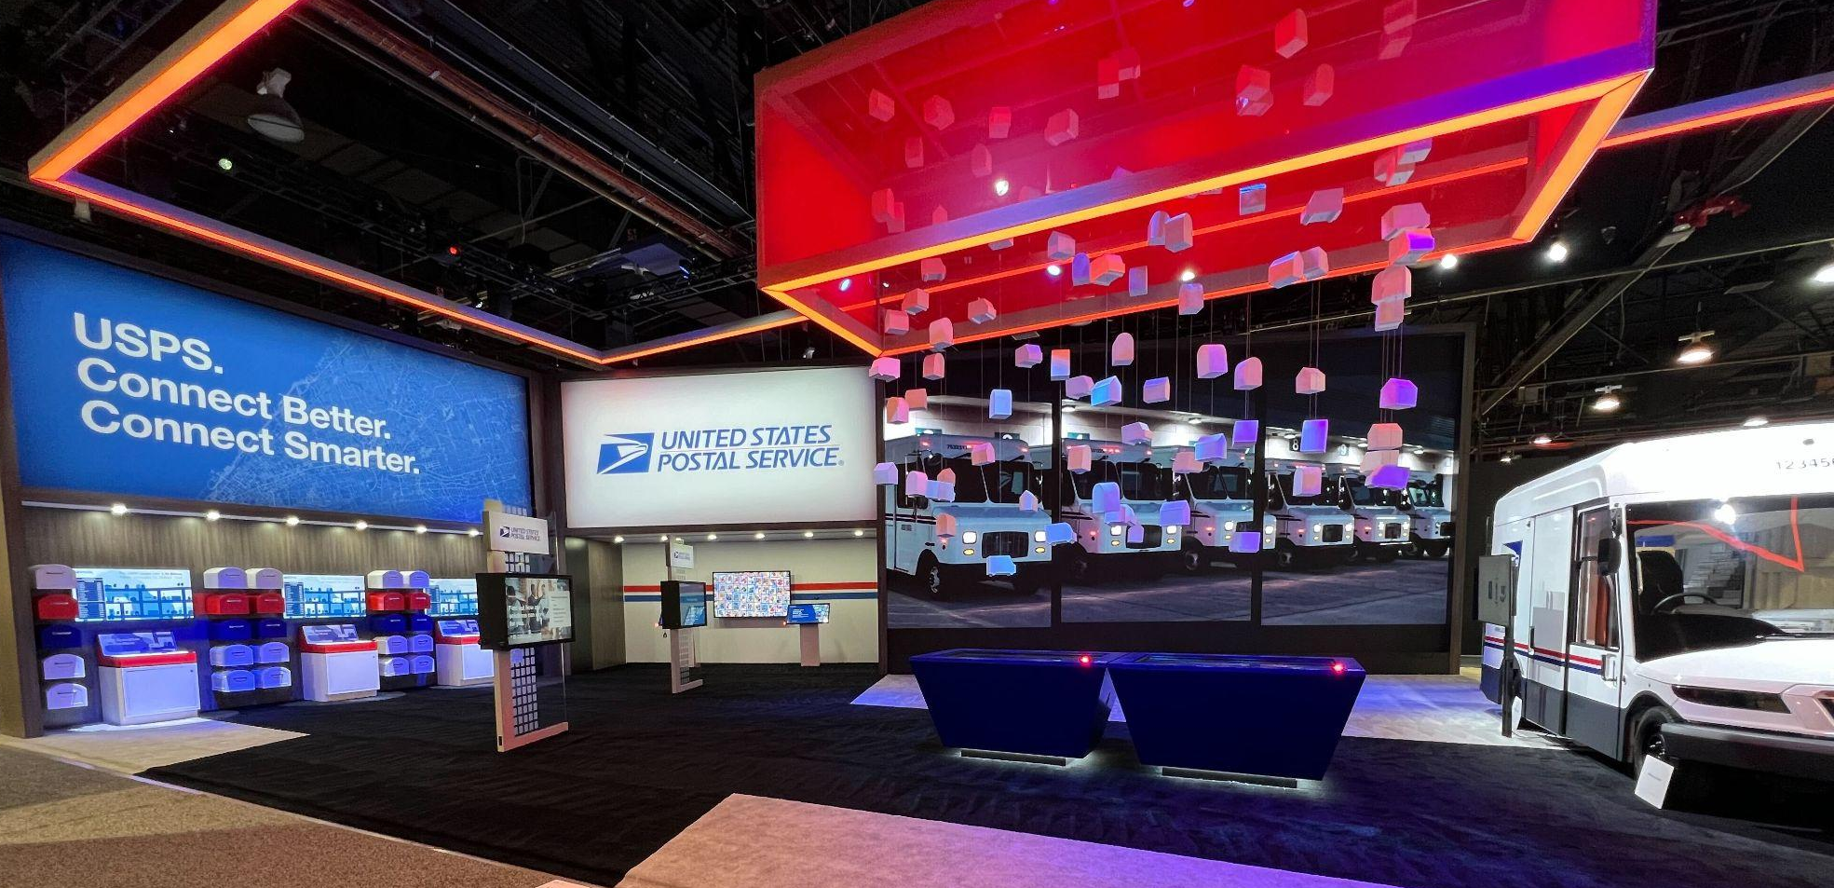
2022 USPS CES

Slide 9
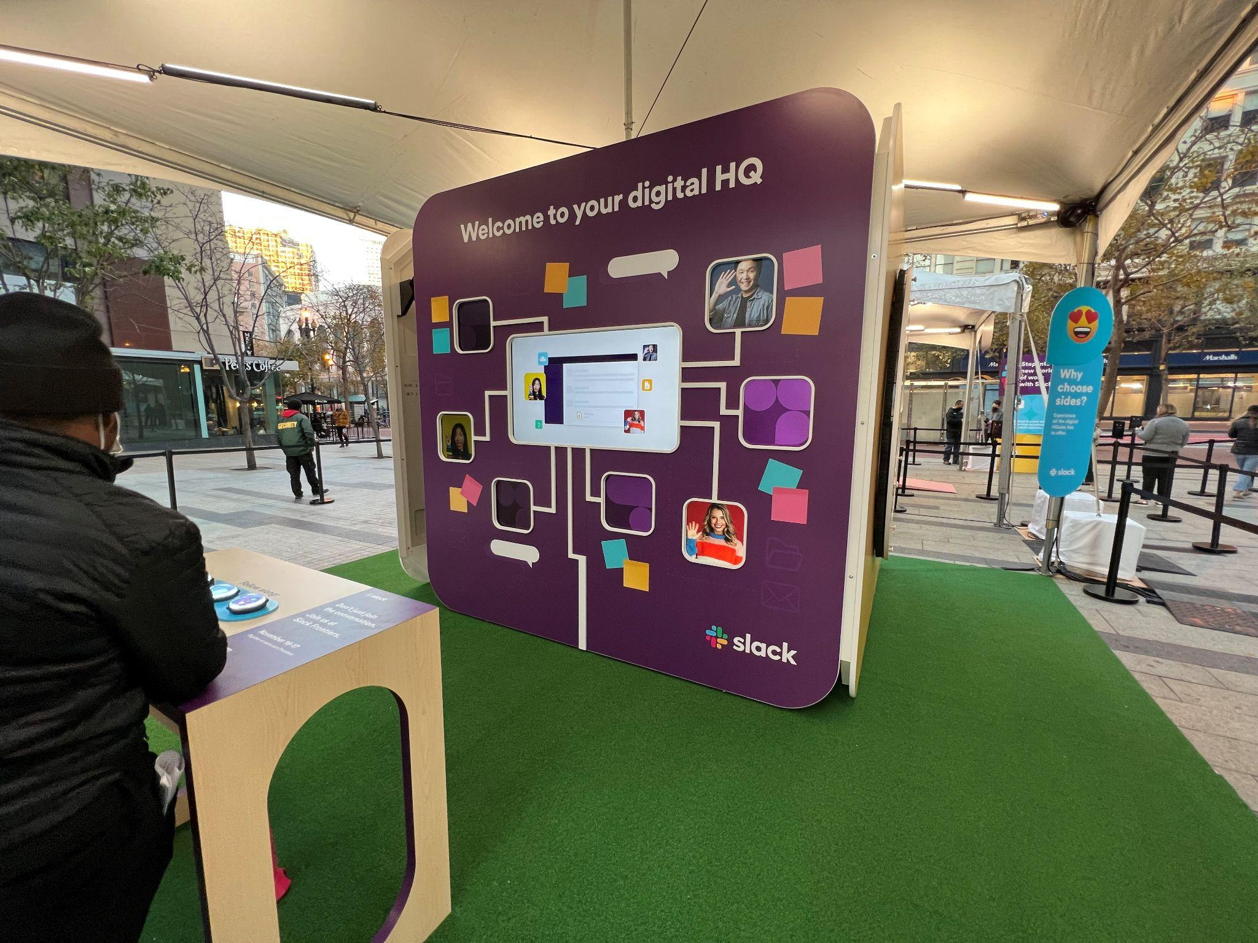
Slack Cube
Vue frontend
Websocket
Arduino

Slide 10
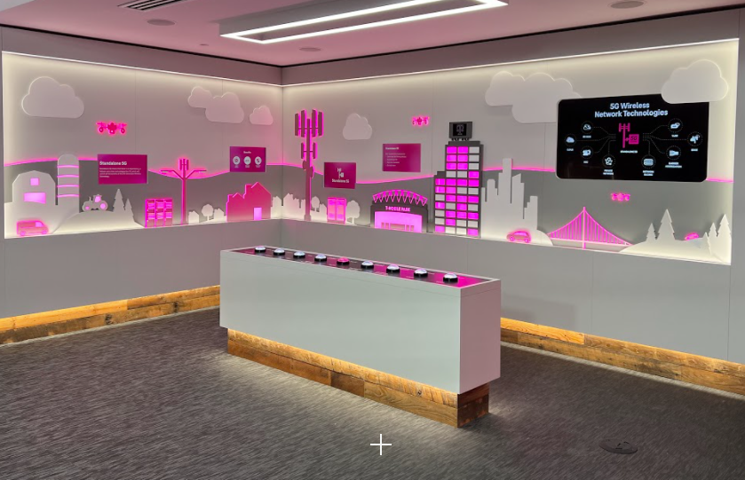
T-Mobile Network Orchestration
Vue frontend
Websocket
DMX

Slide 11
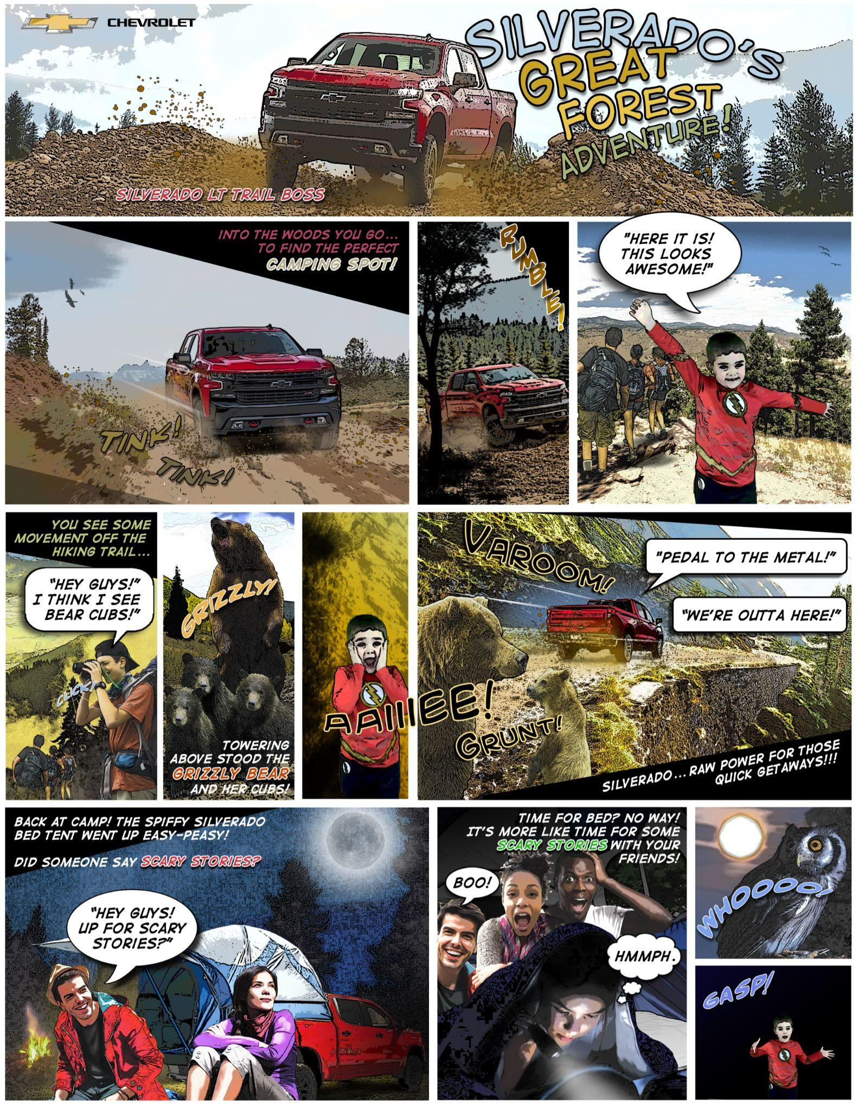
Chevy Comicbook
iPad app
Social-gen sharing

Slide 12

Chevy Trading Cards
iPad app
Social-gen sharing
Physical card takeaway

Slide 13
02
HOW DO WE DO IT?
Notes:
Media & Timing

Slide 14
Tools

Slide 15
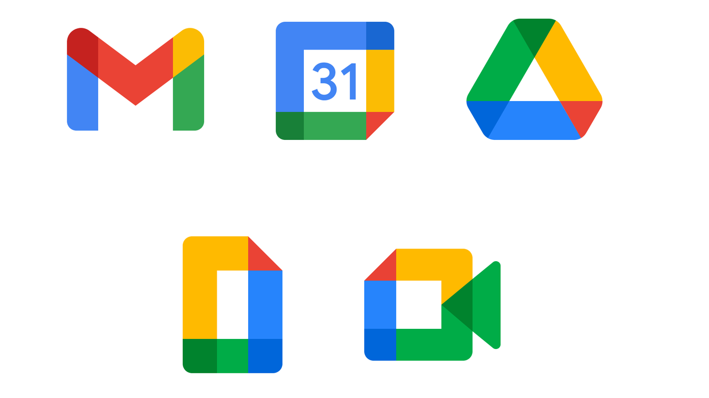
GOOGLE WORKSPACE
Authentication
Gmail
Google Calendar
Google Drive
Docs
Sheets
Slides

Slide 16

SLACK
Quick messages
Problems that don’t need a meeting
Status updates
Images of progress
Simple file

Slide 17

GITHUB
Stores code and small assets
Triggers actions to deploy code
Cloud git branches:
feature/* -> dev
release/* -> qa
master -> prod

Slide 18

MONDAY.COM
Project tracker
Task tracker
Use comments to keep track of changes
Chat using slack

Slide 19

AMAZON WEB SERVICES
Our standard cloud resource provider
Route53 for DNS
S3 for files
CloudFront CDN
EC2 with Kubernetes for Compute
RDS for Databases often Mysql
VPN to connect to cloud resources

Slide 20

VAULT
Secrets manager
Database details
Third party API keys
Can be used for env variables
Projects have infrastructure secrets
Cannot be modified
Where you can find db details

Slide 21
Systems
Runtimes
Frameworks

Slide 22
VUE
JavaScript framework for building user interfaces
Uses components and views
Components assembled from bound data
Updates will refresh the dom
Has a router and store
Has many plugins and components online

Slide 23
NODE.JS
JavaScript runtime we use for servers
Can send and received many protocols
http + websocket
udp + tcp + dmx + artnet + usb
Communicates to the database
Apis, crons, and queues for invocation
Many packages available from npm

Slide 24
MYSQL
Mysql is used both onsite and in the cloud
Sequelize orm is used for both
Migrations define schema changes
Models describe the current schema
Repositories hold the queries

Slide 25
24G TEMPLATES
Vue Template: https://github.com/twentyfourg/vue-template
Local Activation Template: https://github.com/twentyfourg/activation-template-backend-local
Cloud Activation Template: https://github.com/twentyfourg/activation-template-backend-cloud
Vue separates: components, views, store files, router files
Express separates: controllers, database files, middleware, utils, router files
eslint + prettier to check code follows convention
setup script in express-template

Slide 26
The Process

Slide 27
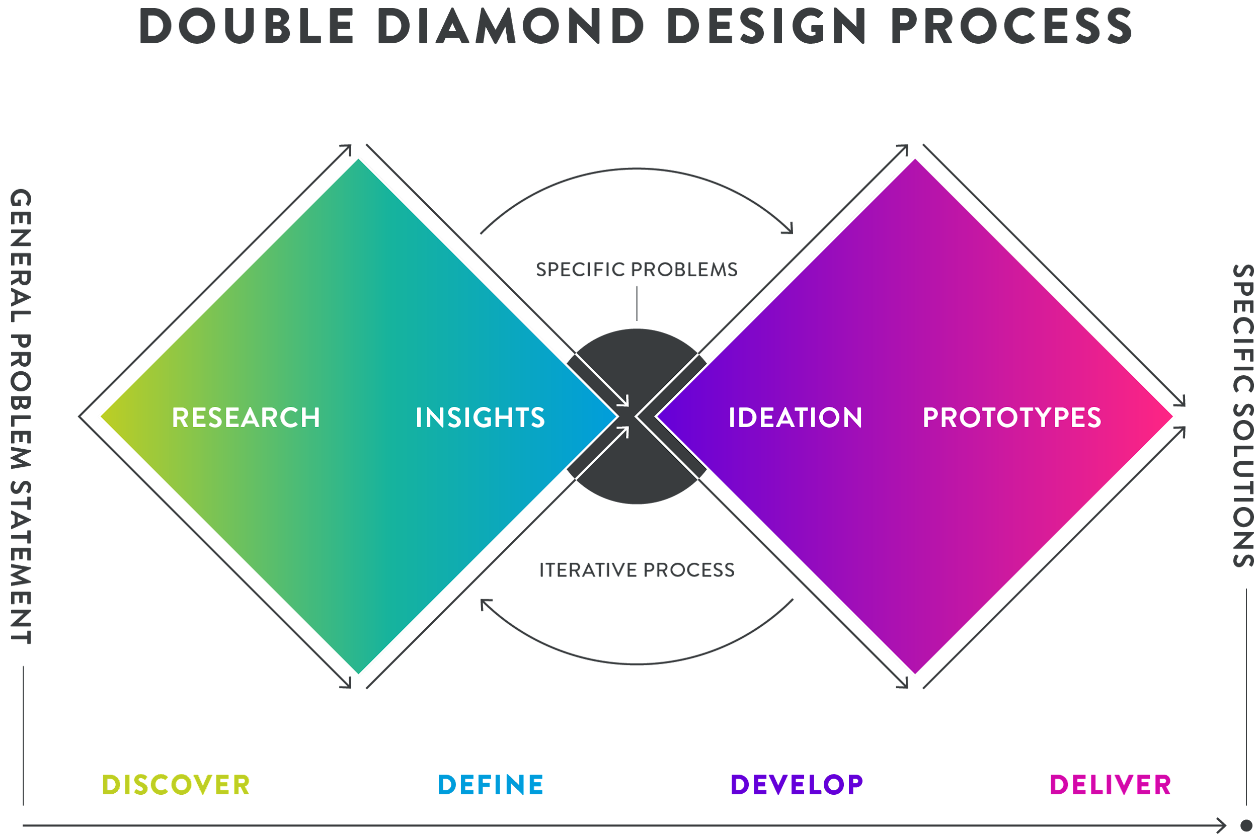

Slide 28
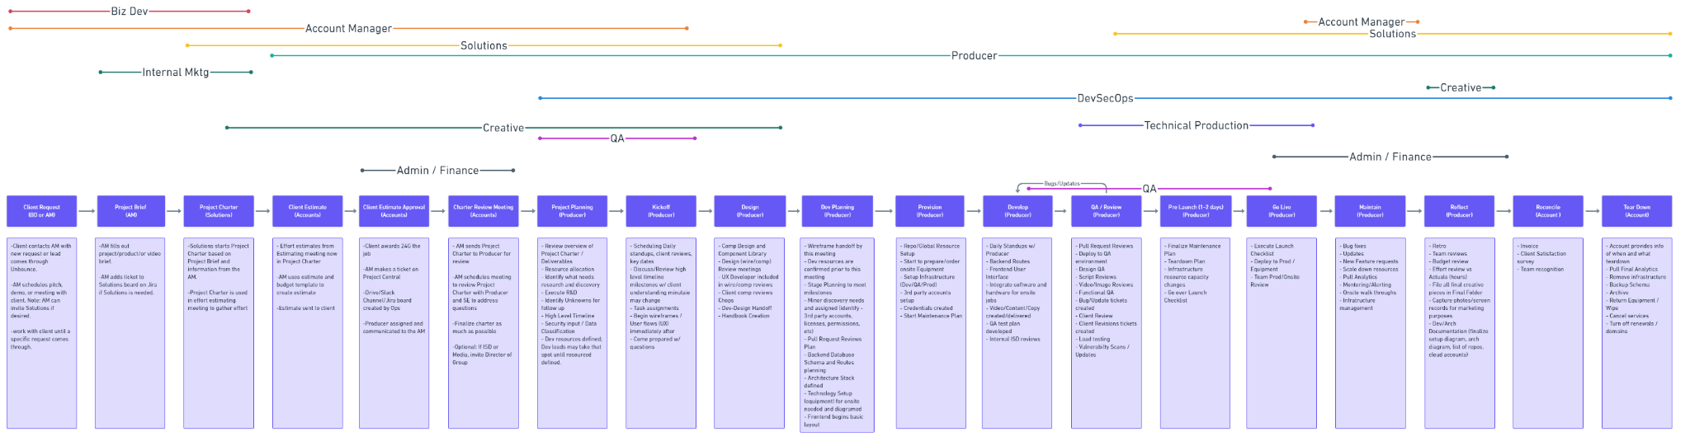

Slide 29
CLIENT REQUEST
A client contacts an AM with a new request
The AM gathers information about the request and starts a project brief
Solutions will use this brief to start a project charter (Scope of work)

Slide 30
ESTIMATION
Solutions bring the project charter to leads to get an estimation of the time and resources needed
Estimations are given to the client for approval

Slide 31
CHARTER REVIEW
The items approved from the Charter are explained to the producer
Charter is reviewed for missing details

Slide 32
PROJECT PLANNING
Leads from departments relevant to the scope of the project are brought in to discuss a high level plan and how to break down the project
Producers will build a timeline for the project after this meeting
Resources are assigned here or in a separate resourcing meeting using the timeline

Slide 33
KICKOFF MEETING
Request and timeline explained to the team
Bring up concerns asap

Slide 34
DEV PLANNING
Meeting for the pm and developers to figure out how to build a project
Where cloud resources requirements are planned
Where physical device requirements are planned

Slide 35
STAND-UP
A usually daily check-in to coordinate progress
Be prepared to discuss what you did yesterday
Be ready to make a plan for today
Bring up any still pending issues

Slide 36
TEAM REVIEW
Be prepared to test the project and any integrations
Keep track of what updates are needed
Prepare for client review updates

Slide 37
RETRO
Follow an exercise to looks for opportunity to make improvements

Slide 38
03
WHO DOES IT?
Notes:
Media & Timing

Slide 39
The Team

Slide 40



Accounts
Daron Harvey
Jackie McDonald
Cody Kabisa
Director of Account Services
Account Manager
Jr. Account Manager

Slide 41



Producers
Amanda Reynolds
Bethany Garcia
Shaundra Boone
Sr. Producer
Producer
Producer

Slide 42




Experiential Developers
Graham Hervey
Greg Schoberth
Ian Hanagan
Matt Crandell
Developer
Developer
Developer
Developer

Slide 43




Experiential Developers Cont.
Ethan Matzdorf
Neil Dennis
Faizan Akheel
Tyler Senkbeil
Jr Developer
Jr Developer
Jr Developer
Jr Developer

Slide 44


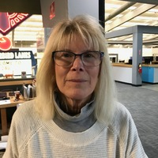
Production
Sean May
Dan Gies
Ann Kendall
Director of Production
Inventory, Shipping, Purchasing
Office Manager

Slide 45

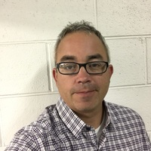

Onsite
Production
Chris Loveday
Parmer Hill
Josh Lingerfelt
Sr. Technical Manager
Sr. Onsite Technician
Onsite Technician

Slide 46
SOME REMINDERS
Google’s usually the authentication
Github holds the code, templates, handles deployments
Monday has task and project info

